Slide 1
Locality Sensitive Discriminant Analysis
Authors: D. Cai, X. He, K. Zhou, J. Han, H. Bao
Reporter: Yunfei Wang
Sep. 28,2012

Slide 2
Outlines
Linear Discriminant Analysis(LDA)
Locality Sensitive Discriminant Analysis(LSDA)
Marginal Fisher Analysis(MFA)
Experimental Results
Summary-Comparison between LDA,LSDA and MFA

Slide 3
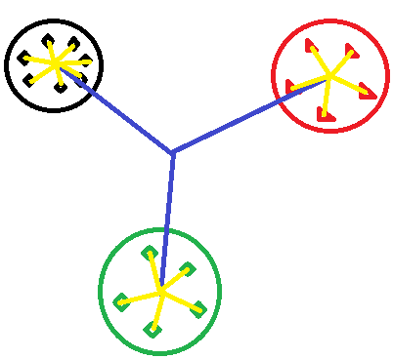
Linear Discriminant Analysis
Maximizing the ratio of inter-class variance to the intra-class variance in any particular data set thereby guaranteeing maximal separability.

Slide 4
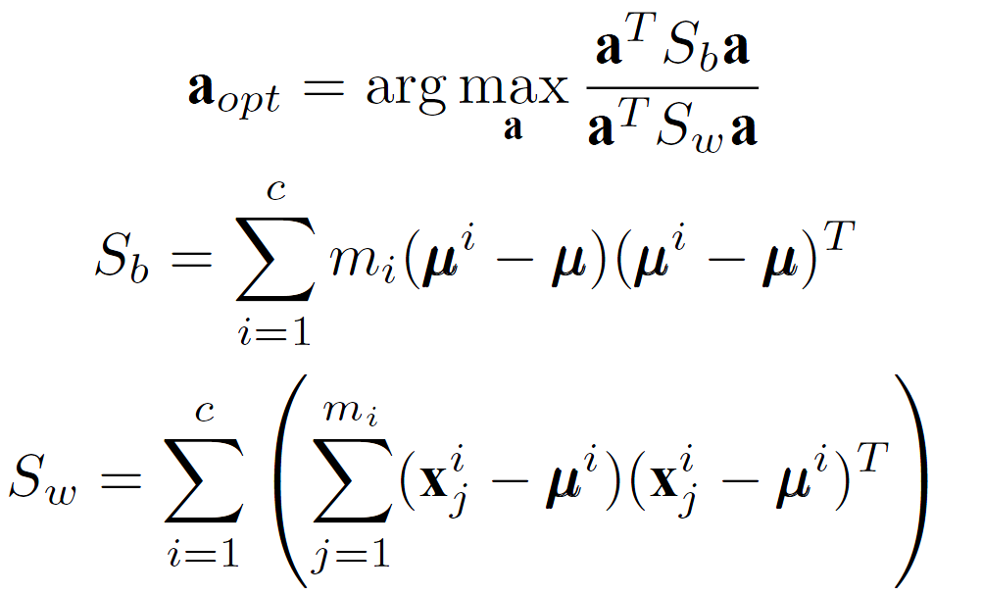

LDA-Objective Function

Slide 5
Drawbacks of LDA
It’s motivated by the assumption than the data of each class is Gaussian distributed, which is not always satisfied in real world problems. Without Gaussian distribution assumption, the inter-class scatter can’t well characterize the separability of the data of different class.
LDA fails to discover the intrinsic local geometrical structure of the data manifold while trying to preserve the global class relationship.

Slide 6
LSDA
Estimating geometrical and discriminant properties of the submanifold form random points lying on this unknown submanifold.
Finding a projection which maximizes the margin between data points from different class at each local area.

Slide 7
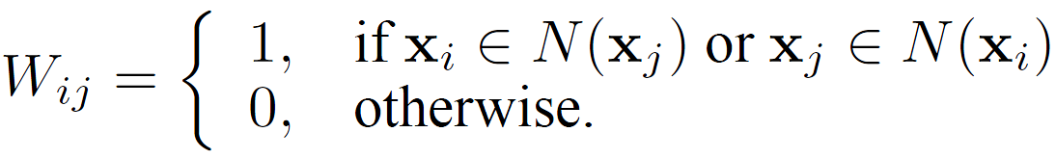
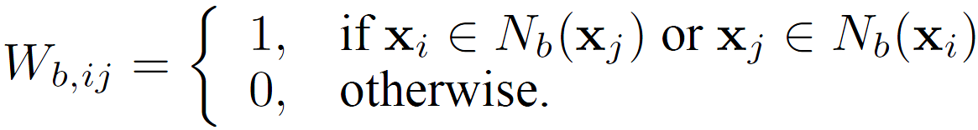
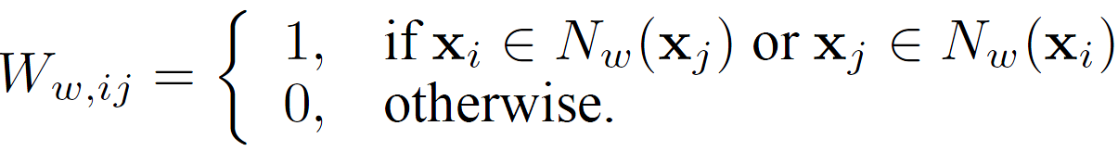
LSDA-Neighbor Graph
Global neighbor graph
Inter-class neighbor graph
Intra-class neighbor graph

Slide 8
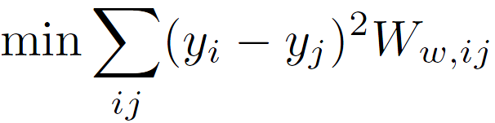
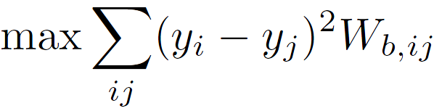
LSDA-Objective Functions
After mapping the intra-class graph and inter-class graph to a projection vector a, we get a map
Minimizing the intra-class scatter:
Maximizing the inter-class scatter:

Slide 9
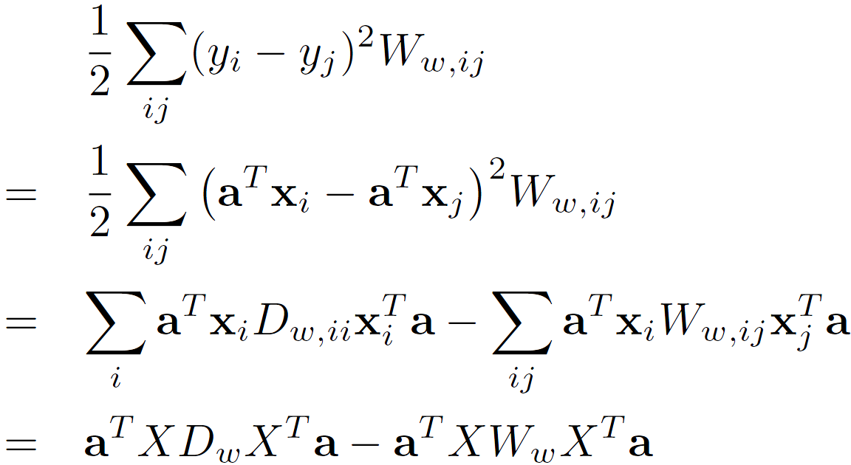
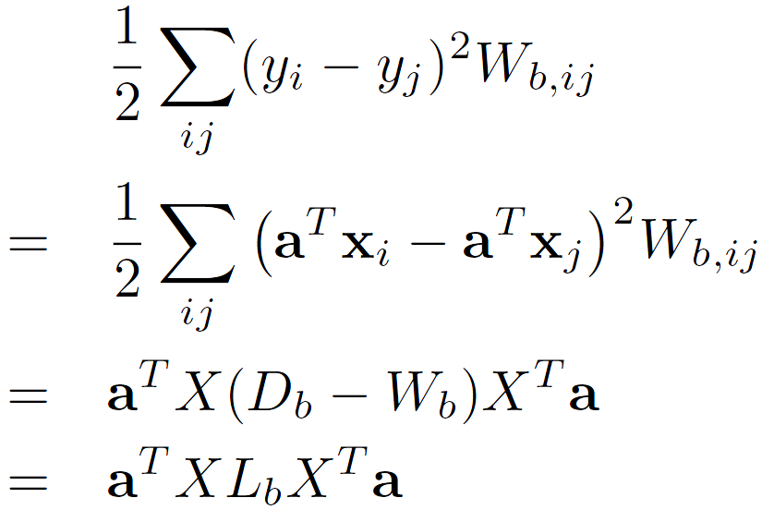
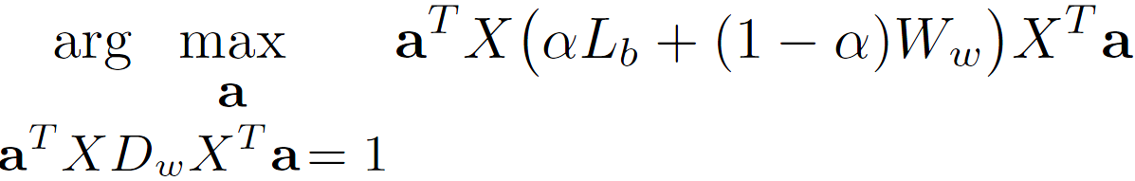
LSDA-Optimal Linear Embedding
Constraint:
Final Optimization Problem:

Slide 10
Marginal Fisher Analysis
MFA has the same goal with LDA, but uses different criterion to characters the intra-class compactness and the inter-class separability.
Intra-class compactness: sum of distances between each point and its nearest neighbors of the same class.
Inter-class separability: sum of distances between margin points and their neighboring points of different classes.
MFA overcomes the limitation of Gaussian distribution assumption of LDA.

Slide 11
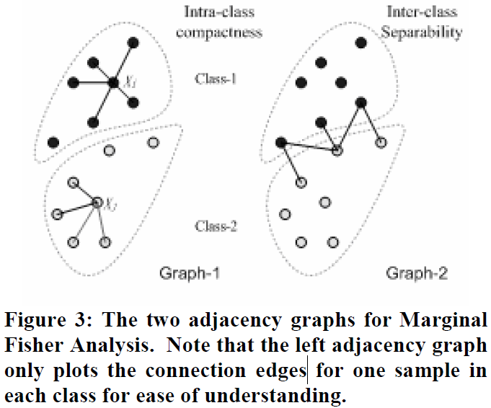
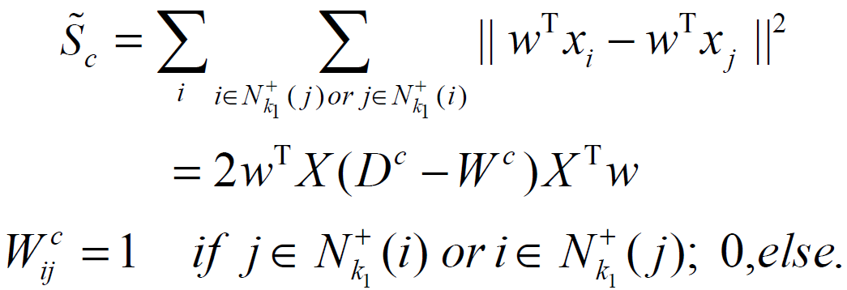
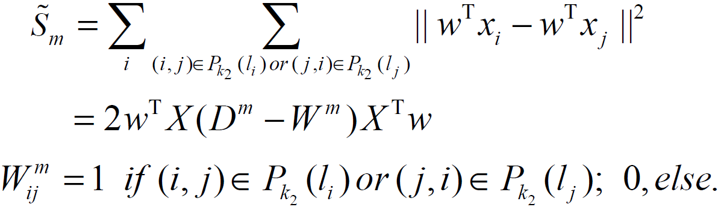
MFA-Criterions
Intra-class compactness:
Inter-class separability:

Slide 12
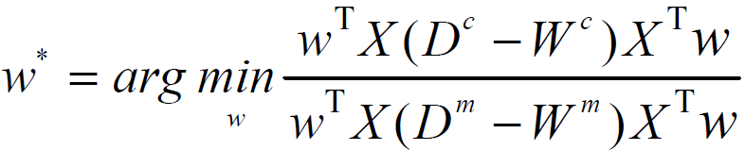

MFA-Algorithmic Procedure
PCA projection: projecting the data into PCA subspace by remaining N-N_{c} dimensions. W_{PCA} denotes the transformation matrix of PCA.
Constructing the intra-class compactness and inter-class separability graphs W^{c} and W^{m}.
Marginal Fisher Criterion:
Output the final linear projection direction:

Slide 13
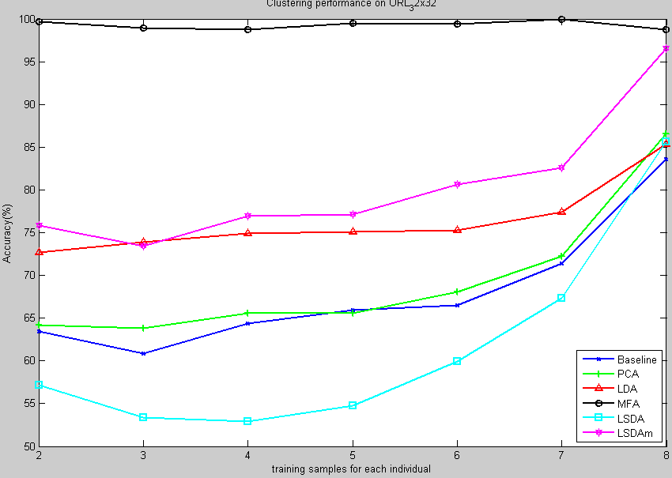
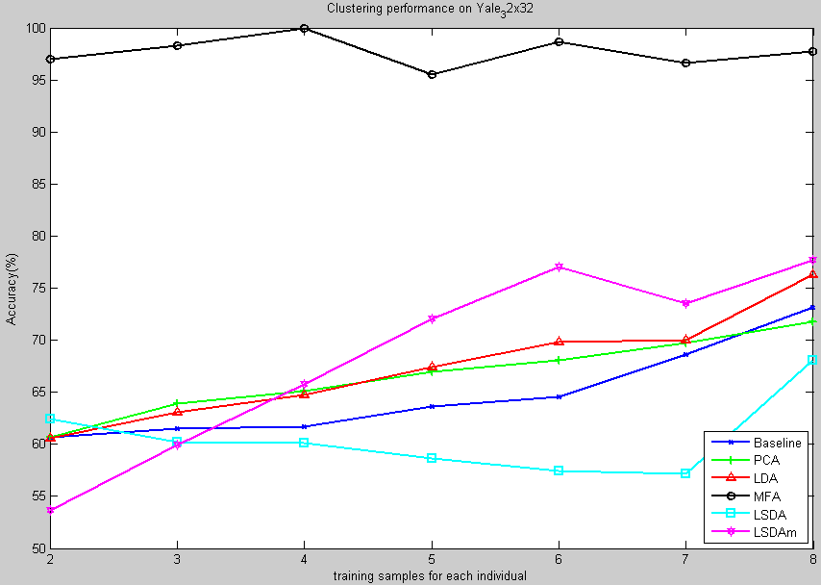
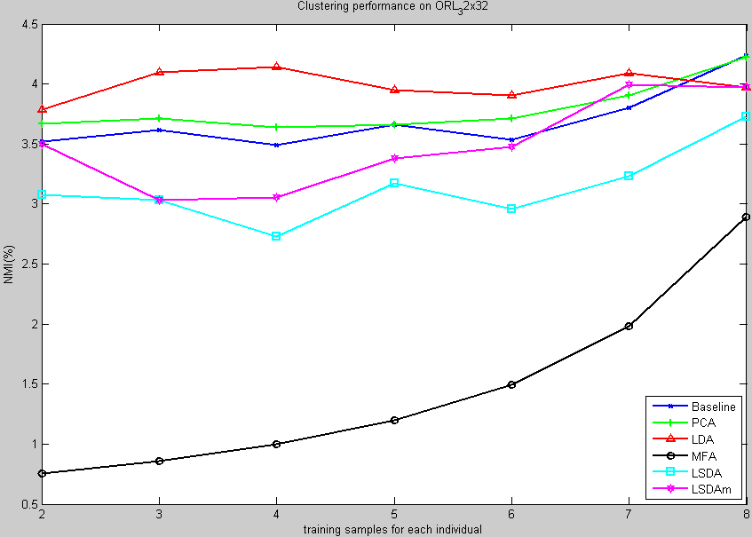
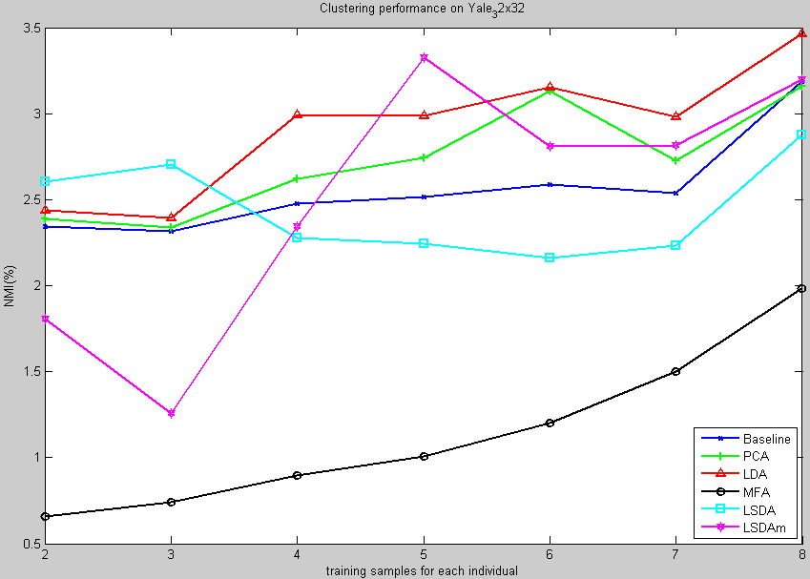
Experimental Results

Slide 14
Comparison
Sharing points: compact the points of each class and separate the different classes as much as possible.
LDA: mainly focus on the global geometry structure.
LSDA: takes the local submanifold into consideration.
MFA: takes advantage of a new criterion to estimating the intra-class and inter-class scatter.

